Slide 1
Simulated Annealing
Mohamamd mahmodui

Slide 2
Road Map
Local search
Basic concepts
What is annealing
Motivation to use simulated annealing
SA parameters

Slide 3

Local Search

Slide 4
Local Search
Improve a single option until you can’t make it better
Successor function: local changes
Generally much faster and more memory efficient than other search methods (but incomplete and suboptimal)

Slide 5
Hill Climbing
Simple, general idea:
Start wherever
Repeat: move to the best neighboring state
If no neighbors better than current, quit
What’s bad about this approach?

Slide 6
Hill Climbing Diagram

Slide 7
What is annealing
A technique involving heating and controlled cooling of a material to increase the size of its crystals and reduce their defects.
Heating and cooling the material affects both the temperature and the thermodynamic free energy.

Slide 8
Simulated Annealing (SA)
SA is a probabilistic technique for approximating the global optimum of a given function.
Idea: Escape local maxima by allowing downhill moves
But make them rarer as time goes on
Accept downhill moves by probability of P(X) for state X.

Slide 9



Simulated Annealing
Theoretical guarantee:
Stationary distribution:
If T decreased slowly enough, will converge to optimal state!
$$P\left(x\right)∝e^{\frac{E(x)}{kT}}$$

Slide 10
Some of SA parameters
Energy Function
Acceptance Function
Initial Temperature
Cooling schedule

Slide 11
Acceptance Function
At high temperatures:
The probability of accepting downhill moves is high.
T=∞ means all moves are accepted
At low temperatures:
The probability of accepting downhill moves decreases.
T=0 means no downhill moves are accepted
The search is equivalent to local search

Slide 12
Initial Temperature
If starting temperature is very high,
the search will be a random local search for a period of time
The main drawback -> high computational cost
If starting temperature is very low,
The search will be a Hill climbing search

Slide 13


Cooling schedule
Fast
Slow

Slide 14
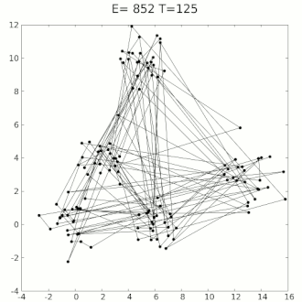
Traveling Salesman Problem

Slide 15
Questions ?
Local search cannot pass local minima
Main Idea of SA: Escape local maxima by allowing downhill moves
Energy function
Acceptance function
Initial temperature
Cooling schedule
$$P\left(x\right)∝e^{\frac{E(x)}{kT}}$$

Slide 16
References
UC Berkeley CS188 Intro to AI
slideshare.net/kaalnath/simulated-annealingppt (contains multiple references)
Wikipedia

